Slide 1
Java Fundamentals 1

Slide 2
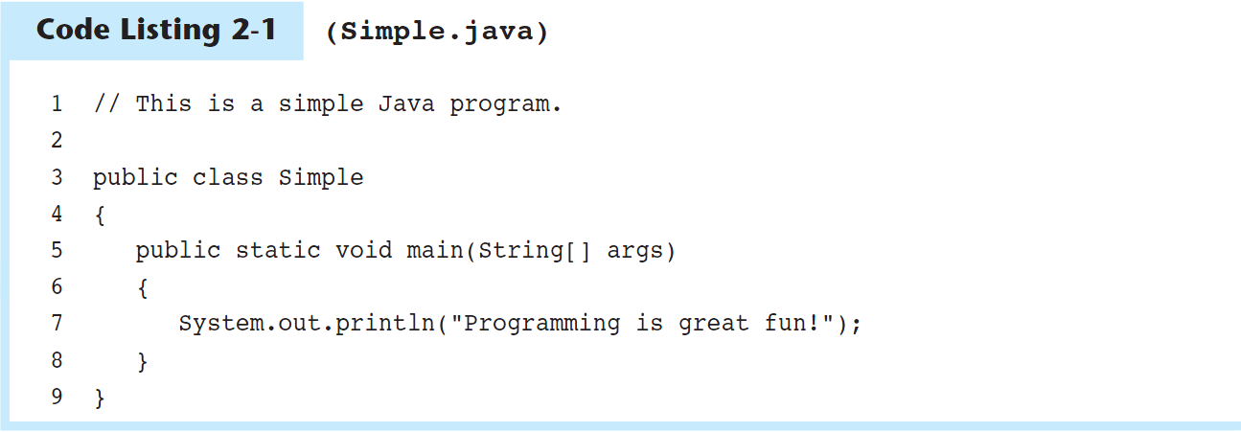
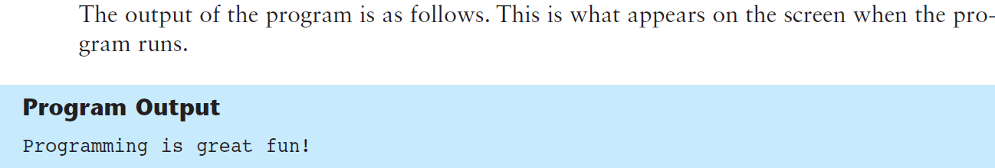
The Parts of a Java Program

Slide 3
The Parts of a Java Program (cont’d.)
To compile the example from the command prompt:
javac Simple.java
Notice the .java file extension is needed.
This will result in a file named Simple.class being created.
You must be in the directory where the file is stored
To run the example:
java Simple
Notice there is no file extension here.
The java command assumes the extension is .class.

Slide 4
The Parts of a Java Program (cont’d.)
The // in line 1 marks the beginning of a comment.
The compiler ignores everything from the double slash to the end of the line.
Comments are not required, but comments are very important because they help explain what is going on in the program.
Comment

Slide 5
The Parts of a Java Program (cont’d.)
Line 2 is blank.
Blank lines are often inserted by the programmer because they can make the program easier to read.
Blank Line

Slide 6
The Parts of a Java Program (cont’d.)
Line 3 is known as a class header, and it marks the beginning of a class definition.
This line of code tells the compiler that a publicly accessible class named Simple is being defined.
A Java program must have at least one class definition.
Class Header

Slide 7
The Parts of a Java Program (cont’d.)
Line 4 contains an opening brace, and it is associated with the beginning of the class definition.
The last line in the program, line 9, contains the closing brace.
Everything between the two braces is the body of the class named Simple.
Opening Brace
Class Body
Closing Brace

Slide 8
The Parts of a Java Program (cont’d.)
Line 5 is known as a method header, and it marks the beginning of a method.
The name of the method is main, and the rest of the words are required for the method to be properly defined.
Every Java application must have a method named main.
The main method is the starting point of the application.
Method Header

Slide 9
The Parts of a Java Program (cont’d.)
Line 6 contains an opening brace that belongs to the main method, and line 8 contains the closing brace.
Everything between the two braces is the body of the main method.
Make sure to have a closing brace for every opening brace in your program.
Opening Brace
Method Body
Closing Brace

Slide 10
The Parts of a Java Program (cont’d.)
Line 7 contains a statement that displays a message on the screen.
The group of characters inside the quotation marks is called a string literal.
At the end of the line is a semicolon; it marks the end of a statement in Java.
Not every line of code ends with a semicolon, however.
Statement

Slide 11
The Parts of a Java Program (cont’d.)
Java is a case-sensitive language.
All Java programs must be stored in a file with a .java file extension.
Comments are ignored by the compiler.
A .java file may contain many classes but may only have one public class.
If a .java file has a public class, the class must have the same name as the file.
Java applications must have a main method.
For every left brace, or opening brace, there must be a corresponding right brace, or closing brace.
Statements are terminated with semicolons, but comments, class headers, method headers, and braces are not.

Slide 12
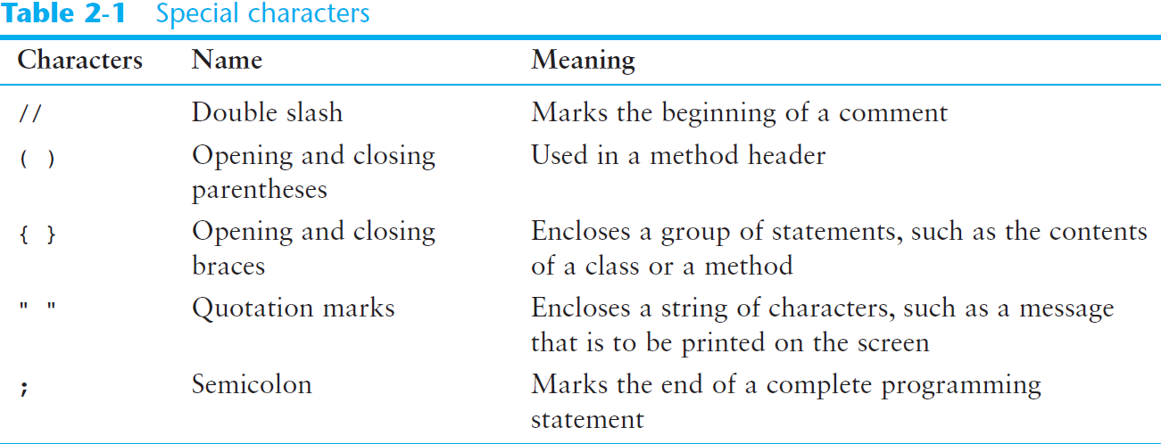
The Parts of a Java Program (cont’d.)

Slide 13
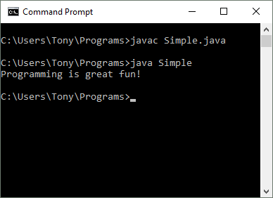
The System.out.print and System.out.println Methods, and the Java API
Many of the programs that you will write will run in a console window.

Slide 14
The System.out.print and System.out.println Methods, and the Java API (cont’d.)
The console window that starts a Java application is typically known as the standard output device.
The standard input device is typically the keyboard.
Java sends information to the standard output device by using a Java class stored in the standard Java library.

Slide 15
The System.out.print and System.out.println Methods, and the Java API (cont’d.)
Java classes in the standard Java library are accessed using the Java Applications Programming Interface (API).
The standard Java library is commonly referred to as the Java API.

Slide 16
The System.out.print and System.out.println Methods, and the Java API (cont’d.)
The previous example uses the line:
System.out.println("Programming is great fun!");
This line uses the System class from the standard Java library.
The System class contains methods and objects that perform system level tasks.
The out object, a member of the System class, contains the methods print and println.

Slide 17
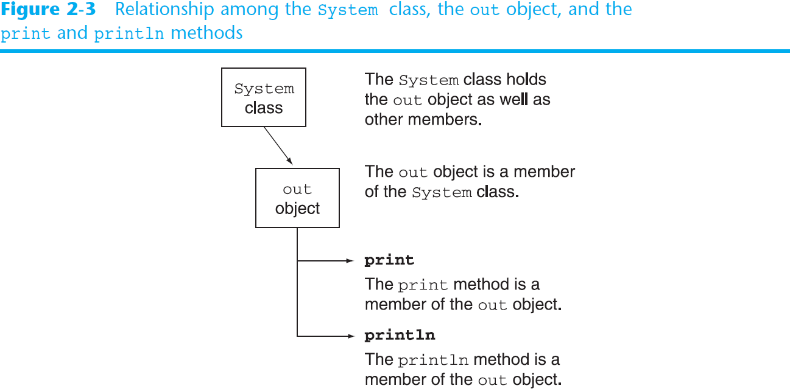
The System.out.print and System.out.println Methods, and the Java API (cont’d.)

Slide 18
The System.out.print and System.out.println Methods, and the Java API (cont’d.)
The print and println methods actually perform the task of sending characters to the output device.
The line:
System.out.println("Programming is great fun!");
is pronounced: “system dot out dot print line”
The value inside the parenthesis, called an argument, will be sent to the output device (in this case, a string).

Slide 19
The System.out.print and System.out.println Methods, and the Java API (cont’d.)
The println method places a newline character at the end of whatever is being printed out.
The following lines:
System.out.println("This is being printed out");
System.out.println("on two separate lines.");
Would be printed out on separate lines since the first statement sends a newline command to the screen.

Slide 20
The System.out.print and System.out.println Methods, and the Java API (cont’d.)
The print statement works very similarly to the println statement.
However, the print statement does not put a newline character at the end of the output.
The lines:
System.out.print("These lines will be");
System.out.print("printed on");
System.out.println("the same line.");
Produce the following output: These lines will beprinted onthe same line.
Notice the odd spacing?
Why do some words run together?

Slide 21
The System.out.print and System.out.println Methods, and the Java API (cont’d.)
For all of the previous examples, we have been printing out strings of characters.
Later, we will see that much more can be printed.
There are some special characters that can be put into the output. System.out.print("This will have a newline.\n");
The \n in the string is an escape sequence that represents the newline character.
Escape sequences allow the programmer to print characters that otherwise would be unprintable.

Slide 22
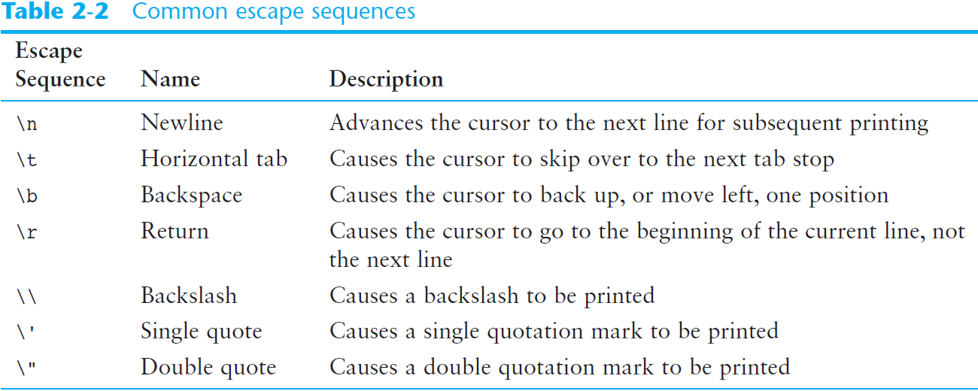
The System.out.print and System.out.println Methods, and the Java API (cont’d.)

Slide 23
The System.out.print and System.out.println Methods, and the Java API (cont’d.)
Even though the escape sequences are comprised of two characters, they are treated by the compiler as a single character.
System.out.print("These are our top sellers:\n");
System.out.print("\tComputer games\n\tCoffee\n ");
System.out.println("\tAspirin");
Would result in the following output:
These are our top sellers:
Computer games
Coffee
Asprin
With escape sequences, complex text output can be achieved.

Slide 24
Variables and Literals
A variable is a named storage location in the computer’s memory.
A literal is a value that is written into the code of a program.(6 is an integer literal, 7.5 if a double literal, “hello” is a string literal etc)
Programmers determine the number and type of variables a program will need.

Slide 25
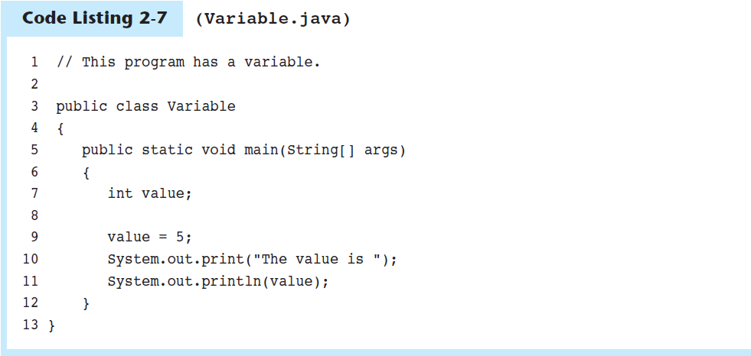
Variables and Literals (cont’d.)
Line 7 contains a variable declaration.
Variables must be declared before they are used.
A variable declaration tells the compiler the variable’s name and the type of data it will hold.
This variable’s name is value, and the word int means that it will hold an integer value.
Notice that variable declarations end with a semicolon.
Variable Declaration

Slide 26
Variables and Literals (cont’d.)
Line 9 contains an assignment statement.
The equal sign is an operator that stores the value on its right (in this case 5) into the variable named on its left.
After this line executes, the value variable will contain the value 5.
Line 9 doesn’t print anything. It runs silently behind the scenes.
Assignment Statement

Slide 27
Variables and Literals (cont’d.)
Line 10 sends the string literal "The value is " to the print method.
Line 11 send the name of the value variable to the println method.
When you send a variable name to print or println, the variable’s contents are displayed.
Notice there are no quotation marks around the variable value.
Display String Literal
Display Variable’s Contents

Slide 28
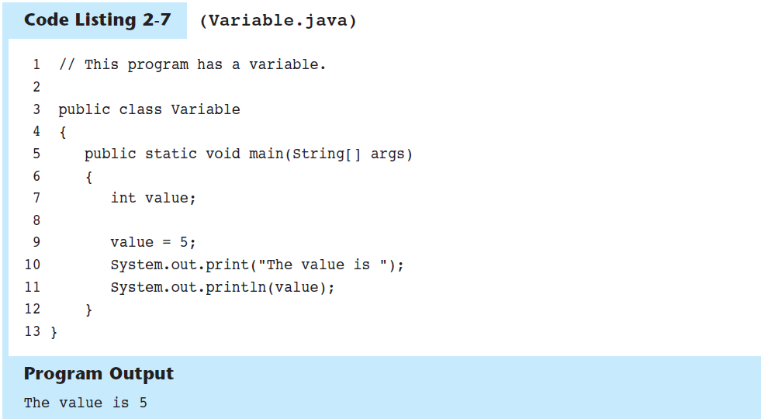
Variables and Literals (cont’d.)

Slide 29
Displaying Multiple Items with the + Operator
The + operator can be used in two ways.
as a concatenation operator
as an addition operator
If either side of the + operator is a string, the result will be a string.
System.out.println("Hello " + "World");
System.out.println("The value is: " + 5);
System.out.println("The value is: " + value);
System.out.println("The value is: " + '/n' + 5);

Slide 30
String Concatenation
Java commands that have string literals must be treated with care.
A string literal value cannot span lines in a Java source code file.
System.out.println("This line is too long and now it has spanned more than one line, which will cause a syntax error to be generated by the compiler. ");

Slide 31
String Concatenation (cont’d.)
The String concatenation operator can be used to fix this problem.
System.out.println("These lines are " +
"now ok and will not " +
"cause the error as before.");
String concatenation can join various data types.
System.out.println("We can join a string to " +
"a number like this: " + 5);

Slide 32
String Concatenation (cont’d.)
The Concatenation operator can be used to format complex String objects.
System.out.println("The following will be printed " +
"in a tabbed format: " +
"\n\tFirst = " + 5 * 6 + ", " +
"\n\tSecond = " + (6 + 4) + "," +
"\n\tThird = " + 16.7 + ".");
Notice that if an addition operation is also needed, it must be put in parenthesis.

Slide 33
Identifiers
Identifiers are programmer-defined names for:
classes
variables
methods
Identifiers may not be any of the Java reserved key words.

Slide 34
Identifiers (cont’d.)
Identifiers must follow certain rules:
An identifier may only contain:
letters a–z or A–Z,
the digits 0–9,
underscores ( _ ), or
the dollar sign ( $ )
The first character may not be a digit.
Identifiers are case sensitive.
itemsOrdered is not the same as itemsordered.
Identifiers cannot include spaces.

Slide 35
Class Names
Variable names should begin with a lower case letter and then capitalize the first letter of each word thereafter:
Ex: int caTaxRate
Class names should begin with a capital letter and each word thereafter should be capitalized.
Ex: public class BigLittle
This helps differentiate the names of variables from the names of classes.

Slide 36
Primitive Data Types
Primitive data types are built into the Java language and are not derived from classes.
There are 8 Java primitive data types.
byte
short
int
long
float
double
boolean
char

Slide 37
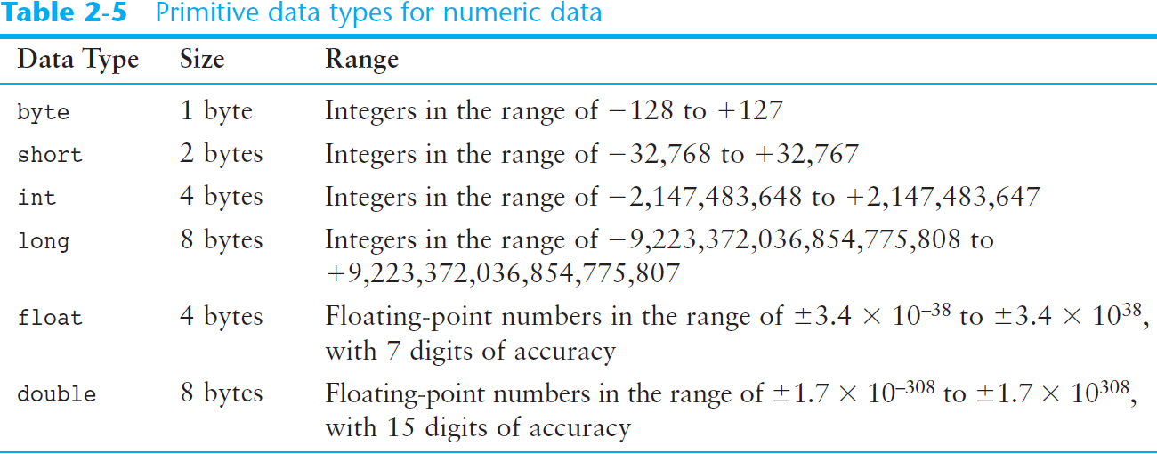
Numeric Data Types

Slide 38
Variable Declarations
Variable Declarations take the following form:
DataType VariableName;
byte inches;
short month;
int speed;
long timeStamp;
float salesCommission;
double distance;

Slide 39
Integer Data Types
byte, short, int, and long are all integer data types.
They can hold whole numbers such as 5, 10, 23, 89, etc.
Integer data types cannot hold numbers that have a decimal point in them.
Integers embedded into Java source code are called integer literals.

Slide 40
Floating-Point Data Types
Data types that allow fractional values are called floating-point numbers.
1.7 and -45.316 are floating-point numbers.
In Java there are two data types that can represent floating-point numbers.
float - also called single precision
(7 decimal points)
double - also called double precision
(15 decimal points)

Slide 41
Floating-Point Literals
When floating-point numbers are embedded into Java source code they are called floating-point literals.
The default data type for floating-point literals is double.
29.75, 1.76, and 31.51 are double data types.
Java is a strongly-typed language

Slide 42
Floating-Point Literals (cont’d.)
Literals cannot contain embedded currency symbols or commas.
grossPay = $1,257.00; // ERROR!
grossPay = 1257.00; // Correct.
Floating-point literals can be represented in scientific notation.
47,281.97 == 4.728197 x 10⁴.
Java uses E notation to represent values in scientific notation.
4.728197X10⁴ == 4.728197E4.

Slide 43
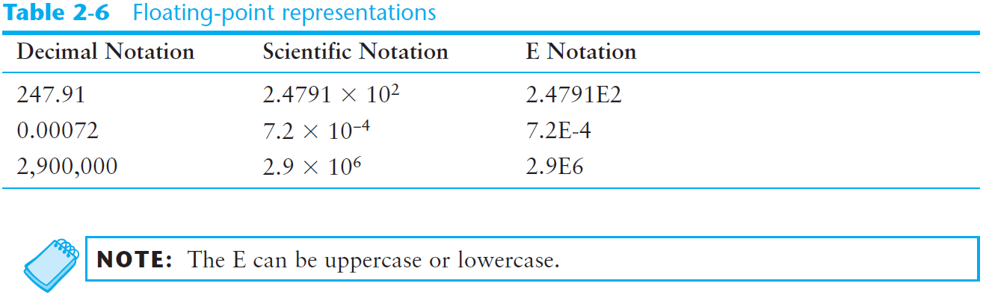
Scientific and E Notation

Slide 44
The boolean Data Type
The Java boolean data type can have two possible values.
true
false
The value of a boolean variable may only be copied into a boolean variable.

Slide 45
The char Data Type
The Java char data type provides access to single characters.
char literals are enclosed in single quote marks.
'a', 'Z', '\n', '1'
Don’t confuse char literals with string literals.
char literals are enclosed in single quotes.
String literals are enclosed in double quotes.

Slide 46
END

